Slide 1
Bipartite Graph on federated learning
research approaches and applications
Sheng Yun
GSAS Data Science – Fordham University
CISC 5835

Slide 2
OUTLINE
What is federated learning
What are the problems
Bipartite Review
How can Bipartite graph help
Approaches related to the data matching
Approaches related to the client and servers matching
Future Directions and Outlook

Slide 3
Federated Learning?
"The way a team plays as a whole determines its success. You may have the greatest bunch of individual stars in the world, but if they don't play together, the club won't be worth a dime." - Babe Ruth

Slide 4


Federated Learning in a nutshell
Federated learning is a type of machine learning where multiple devices, such as smartphones or computers, work together to train a shared model. Each device trains a local model using its own data, and the local models are then aggregated to produce a global model.
Allows for the training of more accurate models without requiring access to all the data on a central server.
Useful in situations where the data is distributed across many devices, or when the data is sensitive and cannot be shared.
Fig.1

Slide 5
Federated learning challenges
Data Heterogeneity | Privacy | cost
Performance degrade | Lack of trust | Communication cost
Convergence | Differential Privacy | Bandwidth

Slide 6

Bipartite Reviews
A bipartite graph has two disjoint sets of nodes connected by edges.
A bipartite matching is a subset of edges without common nodes.
A perfect matching in a bipartite graph connects every node in one set to exactly one node in the other set.
Bipartite graphs and matchings are used in network flow, scheduling, and assignment problems. They can be solved using algorithms such as the Hungarian method and the Gale-Shapley
Fig. 2

Slide 7
How can Bipartite Graphs help?
Match datasets | Matching the clients
Finding the matching row | Find the similar clients
Very limited but will be easy to utilize | Hard to measure the performance
Intuitively, bipartite graph is a tool for visualizing the matchings.
When we have data that have different columns(features)
When we are dealing with many clients, we can group(match or pair) them

Slide 8
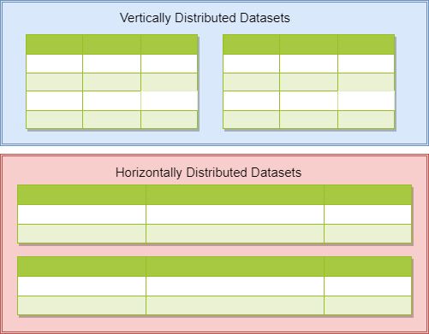
Entity resolution[1]
Entity resolution is the process of identifying and combining multiple records that refer to the same real-world entity. This is also known as record linkage or deduplication.
Entity resolution is important for many applications, such as customer relationship management, fraud detection, and security analysis. By combining duplicate records, organizations can improve the accuracy and usefulness of their data.

Slide 9
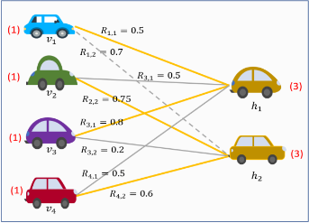
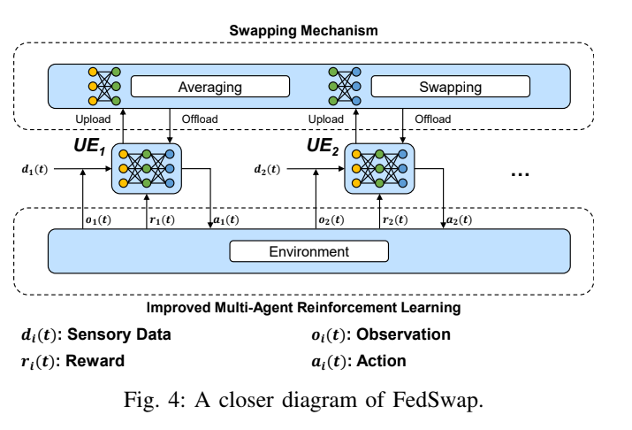
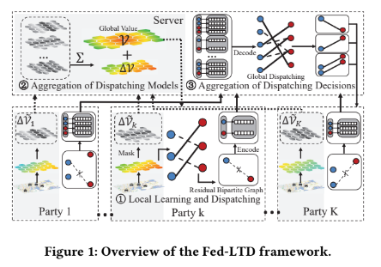
Approach 2 overview
Clustered Vehicular FL[3]
FEDSWAP[2]
Fig. 3(Illustration of the bipartite matching)[3]
FED-LTD[4]
(FEDSWAP)[2]
Fig. 5(FED-LTD)[4])

Slide 10
Algorithms COMPARISON for approach 2
FED-LTD[4]
Clustered Vehicular Federated Learning[3]
federated order dispatching for cross-platform ride hailing
Combined the order dispatching with federated learning
Used: max-weighted bipartite-> Hungarian method; Residual Bipartite(RGB)
Beat the single-platform order dispatching in total revenue by 10.24% ~ 54.07%[4]
Find the most preferred model to train
To maximize the relationship R between two nodes[3]
Used: max-weighted bipartite-> integer linear program(python pkg)
Low-Latency FL Over Wireless Channels[5]
Fedswap: 5G based Dynamic Spectrum Access System[2]
Multi-agent multi-armed bandit (MAMAB) Framework
Used: modified Hungarian algorithm and greedy matching with a better alternative (GMBA)
better channel conditions and computation capabilities->reduce the per round latency[5]
better trade-off between the latency per round and the training performance.[5]
Multi-agent reinforcement learning(iMARL)
Swapping mechanism for aggregating models periodically
Used: KM algorithm
Improved efficiency and fairness[2]

Slide 11
Unresolved problems
privacy | Performance | Practice
What if agents(sub-server) fails | Robustness? | Practical?
Will this prevent attacks | Coincidence? | Necessary?

Slide 12
Future Directions and Outlook
Few comments
Maybe it is a way
Future

Slide 13
Reference
Fig.1: https://pixabay.com/vectors/circuit-board-sphere-ball-3d-orb-6522555/
Fig. 2: https://www.pexels.com/photo/7651924/
Fig. 3: Taïk, A., Mlika, Z., & Cherkaoui, S. (2022). Clustered Vehicular Federated Learning: Process and Optimization. IEEE Transactions on Intelligent Transportation Systems.
Fig. 4: Gao, Z., Li, A., Gao, Y., Li, B., Wang, Y., & Chen, Y. (2021, November). FedSwap: A Federated Learning based 5G Decentralized Dynamic Spectrum Access System. In 2021 IEEE/ACM International Conference On Computer Aided Design (ICCAD) (pp. 1-6). IEEE.
Fig. 5: Wang, Y., Tong, Y., Zhou, Z., Ren, Z., Xu, Y., Wu, G., & Lv, W. (2022, August). Fed-LTD: Towards Cross-Platform Ride Hailing via Federated Learning to Dispatch. In Proceedings of the 28th ACM SIGKDD Conference on Knowledge Discovery and Data Mining (pp. 4079-4089).
Fig. 6: https://pixabay.com/vectors/question-mark-answer-solution-sign-6099556/
[1] Nock, R., Hardy, S., Henecka, W., Ivey-Law, H., Patrini, G., Smith, G., & Thorne, B. (2018). Entity resolution and federated learning get a federated resolution. arXiv preprint arXiv:1803.04035.
[2] Gao, Z., Li, A., Gao, Y., Li, B., Wang, Y., & Chen, Y. (2021, November). FedSwap: A Federated Learning based 5G Decentralized Dynamic Spectrum Access System. In 2021 IEEE/ACM International Conference On Computer Aided Design (ICCAD) (pp. 1-6). IEEE.
[3] Taïk, A., Mlika, Z., & Cherkaoui, S. (2022). Clustered Vehicular Federated Learning: Process and Optimization. IEEE Transactions on Intelligent Transportation Systems.
[4] Wang, Y., Tong, Y., Zhou, Z., Ren, Z., Xu, Y., Wu, G., & Lv, W. (2022, August). Fed-LTD: Towards Cross-Platform Ride Hailing via Federated Learning to Dispatch. In Proceedings of the 28th ACM SIGKDD Conference on Knowledge Discovery and Data Mining (pp. 4079-4089).
[5] Wei, K., Li, J., Ma, C., Ding, M., Chen, C., Jin, S., ... & Poor, H. V. (2021). Low-latency federated learning over wireless channels with differential privacy. IEEE Journal on Selected Areas in Communications, 40(1), 290-307.

Slide 14

Questions?
Fig. 6

